Slide 1

YOUR FARM
Team NOVA
Narendra Mali
Om Prajapati
Vishal Jena
M Naga Sai Arjun

Slide 2
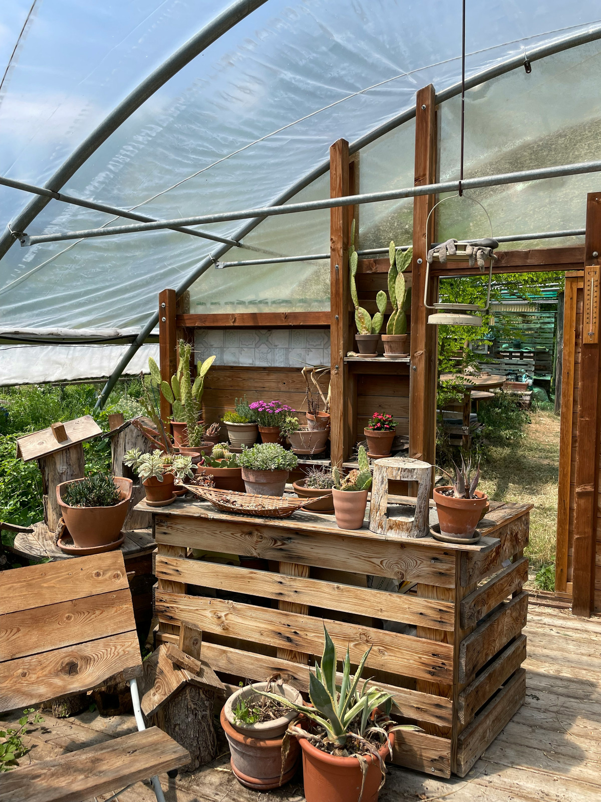
PROBLEM STATEMENT
In today’s fast-paced world, many individuals are increasingly concerned about the health risks associated with artificial, chemical-laden foods. But those with hectic schedules, especially those who work long hours away from home, frequently don't have the time or finances to grow their own fresh, organic fruit. People are further discouraged from pursuing home-based farming by the dearth of easily accessible information and assistance for establishing and managing kitchen or terrace farms. As a result, there is a growing need for solutions that enable individuals to easily grow and access organic food, even within limited spaces or time constraints.

Slide 3
SOLUTION
To address these challenges, our business offers comprehensive solutions that empower individuals to cultivate their own organic produce through kitchen and terrace farming. We provide end-to-end services, including the setup and maintenance of home-based farms, tailored guidance for beginners to make farming easy and accessible, and affordable organic food options for those with limited time. By making sustainable farming practices convenient and practical, we enable busy individuals to enjoy fresh, healthy food while fostering a deeper connection to their food sources.

Slide 4
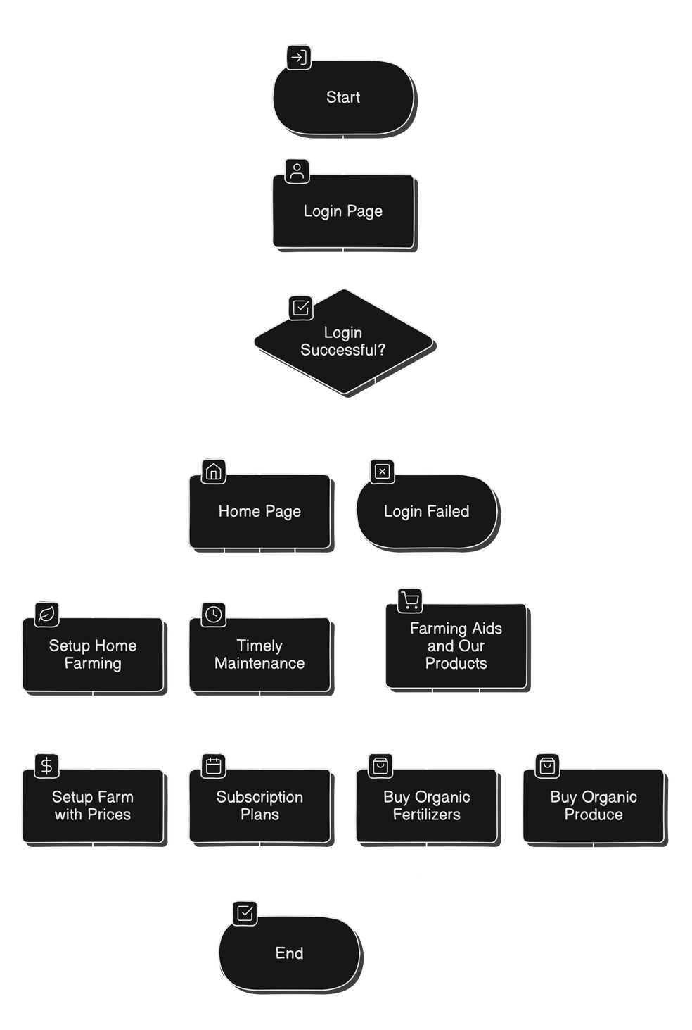

WORKFLOW

Slide 5

TECHNOLOGY STACK
Front-end:
React JS
Tailwind CSS
Back-end:
LARAVEL with Core PHP
MongoDB

Slide 6
THANK YOU

